Slide 1
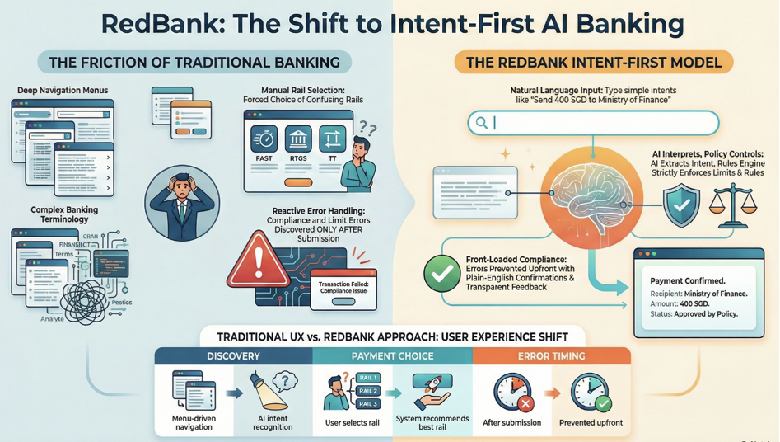

Slide 2
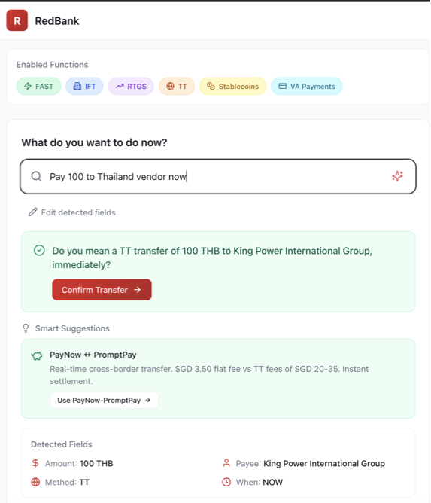
User Input in Plain English
LLM interprets
With contextual data
Vendor ->Specific Payee, Currency
Smart Suggestions / alterative options

Slide 3
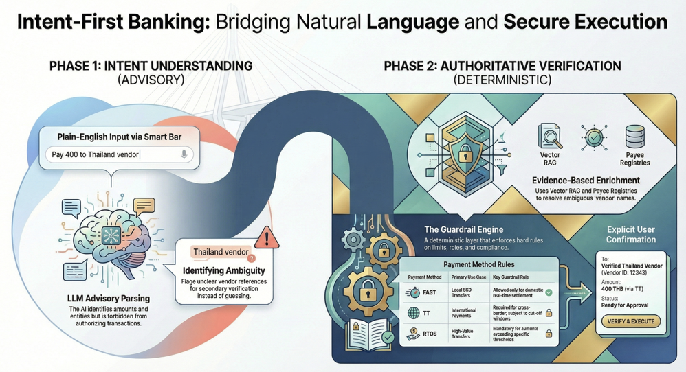

Slide 4
